Slide 1
Healthcare Solutions Presented to:
Daemen College
March 7, 2017

Slide 2
Univera Healthcare
Introduction
Univera Healthcare Overview
Network Advantage
Proven Capabilities
Member Experience
Group Experience
Health & Wellness
Improving Health Outcomes
Implementation Strategy
Question & Answer

Slide 3
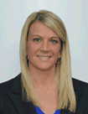
Your Local Sales & Support Team with Executive Sponsor(s)
Art Wingerter
President
Pamela Pawenski
Vice President, Sales
Darren Gress
Director, Sales
David Kurpiewski
Account Manager
Charlie Estes
Senior Vice President, Interactive Health
Katie Henderson
Workplace Wellness Specialist
Patty Brooker
Network Navigator
Laura Hebert
Network Claims Specialist/Process Advisor

Slide 4
Univera Healthcare Overview
1976: Health Care Plan (HCP) incorporated first HMO in WNY
2001: Merged with Excellus Health Plan $7 Billion not-for-profit company
Largest not-for-profit health insurance company in Upstate New York, servicing over 1.6 million lives
Local Network Control in 39 counties of New York

Slide 5
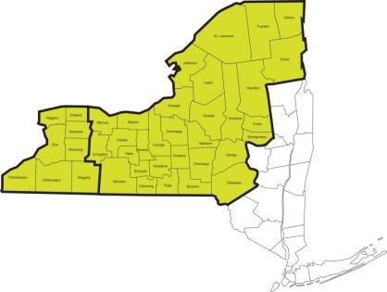
Largest Network in Upstate New York
More than 98% of all providers within our counties participate with us
Univera PPO network covers 39 Upstate NY counties
Includes all major hospitals and strategic physician groups
Competitively negotiated rates
No fees for claims, No fees for network access when using our networks
More direct contract relationships with PA providers than competitors

Slide 6
Network Access Robust Nationwide Networks
More than 800,000 doctors & specialists, 5000 facilities through MultiPlan
If providers are not participating, we will recruit or execute a one time agreement
Participants avoid full payment at the time of service
Network secures discounts for the plan
Dedicated Network Navigator provides support and assistance with access outside of local and national networks
Patricia Brooker, Network Navigator

Slide 7
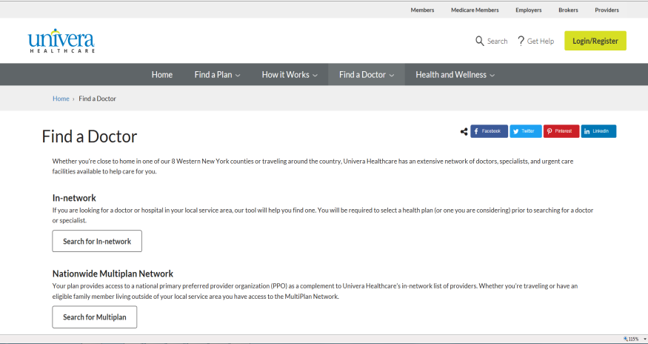
Ease of Navigation

Slide 8
Member Experience

Slide 9
Committed to Serving Your EmployeesYou
Customer service performance:
First Call Resolution
Average Speed of Answer
Inquiries Resolved in 7 Days
75%
63.0
seconds
98.2%
Exceeds industry standards

Slide 10
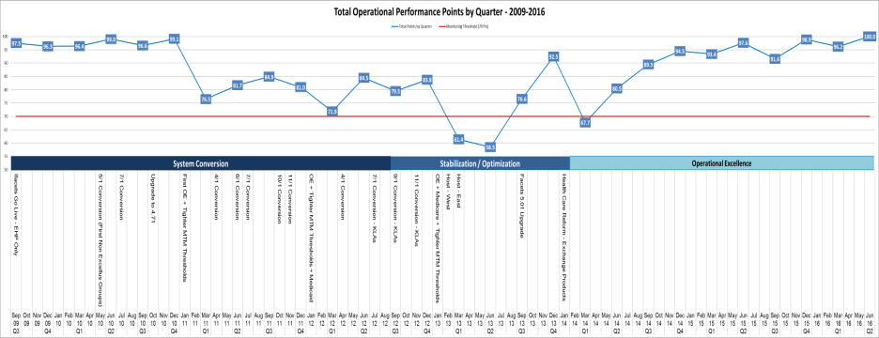
Operational Excellence
Insert MTM graphical pre and post transformation

Slide 11
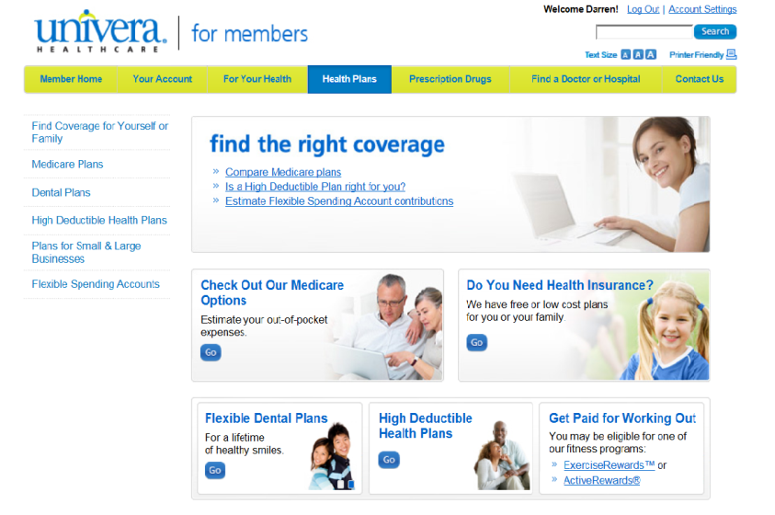
Custom Landing Page
PPC Broadband Group

Slide 12
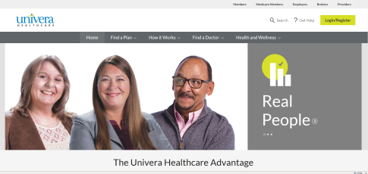
Superior On-Line Services
Self-Service Website with Cost Comparison Tool
View benefits, copay, deductible
Check claims, referrals
Find a doctor or hospital
Order an ID card or print a temporary card
Print claim forms
Start a personal wellness program and track progress
Search health topics, access product discounts, and more!

Slide 13
Paperless Functionality

Slide 14
Mobile Subscriber ID Card

Slide 15
Telemedicine
WHAT IS IT?
→ Low cost access to virtual health care
→ Includes discharge instructions, a prescription if needed
→ Visit note sent to PCP (within 24 hours)
WHERE DO I GET CARE?
→ Call toll free OR
→ See the doctor on your smart phone (app) OR
→ See the doctor on your computer
WHY USE IT?
→ Low cost
→ Ease of use
→ Convenience
→ Feel better quicker
→ Productivity
WHEN CAN I USE IT?
→ Available 24/7, 365 days/year
→ Schedule an appointment
→ Request immediate care**
HOW MUCH DOES IT COST?
→ Total cost for appointment is $40.
→ Members pay $10 copay after deductible has been met.
WHO WILL I TALK WITH?
→ A doctor
For Non-Life Threatening Conditions
Pink eye, Allergies, Sinus Infections, Urinary Tract Infections, Dermatology, Concerns (i.e. Infections, Rashes), Bronchitis and more.
Average time for Telemedicine visit:
→ Average time away from work: 30 minutes
→ Average time to see an MD: 9 minutes
Avg Cost:
ER: $1,198
Office: $103
UC: $166
Confidential and proprietary information
*All fully insured products will have the telemedicine benefit as of 1/1/17!

Slide 16
Workplace Wellness

Slide 17
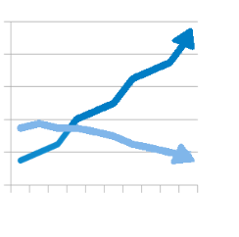
Engaging Employees: Driving Participation, Reducing Costs
Develop risk reduction programs using employee health data
Employee promotion and communication tools
Program options customized to meet employee needs - rewards and or outcomes based
Participation
$$
FitDollars
Univera HealthyU

Slide 18
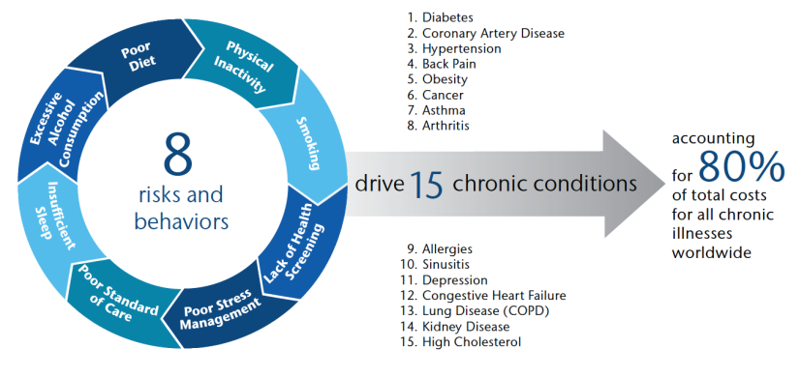
Workplace Wellness
Current State of Health
Current State of Health
If employers could meaningfully impact as few as 3 of the behaviors, they would experience a savings of as much as $700 per employee per year.
Source: Aon Hewitt 2012 Health Care Survey.

Slide 19
Workplace Wellness
Current State of Health
1 in 3 Americans has heart disease
………………………………………………………………………………
1 in 3 Americans have high cholesterol
……………………………………………………………………………...
1 in 3 US adults has high blood pressure (hypertension)
………………………………………………………………………………
1 in 3 US adults has pre-diabetes (metabolic syndrome)
References: American Heart Association, Statistical Fact Sheet, 2012

Slide 20
Workplace Wellness Wellness
Our team is here to help you every step of the way
Certified Workplace Wellness Consultants
Personal Trainers
Registered Nurses
Physicians
Nutrition Specialists
Behavioral Health Specialists
Pharmacy Consultants
Data Analyst
Population Health Expert

Slide 21
Workplace Wellness Wellness
We will work with you to pick the right tools and show you how to use them most effectively
Univera Healthcare Workplace Wellness Consultant
Assess
Provide Support
Implement
Review Results
Plan
Set Goals
Collect Data
Interventions
Interventions
Health Risk
Assessment
Physical Activity
Biometric Screening
Weight Management
Medical Management
Tobacco Cessation
Stress Management
Pharmacy Management
Health Coaching
Discounts & Incentives

Slide 22
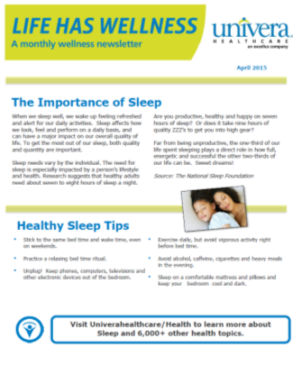
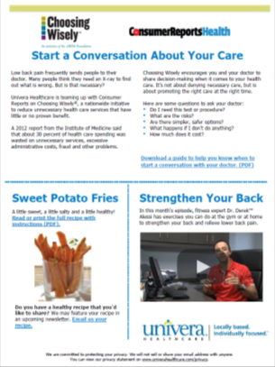
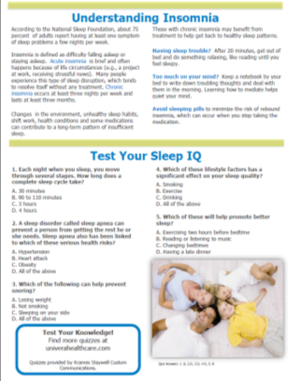
Workplace Wellness
Univera Wellness Newsletter
A monthly publication brought to you by your Workplace Wellness Consultant

Slide 23
Health Education Programs
These programs give your employees the most up-to-date information about important topics
One-hour in person format
15 participant minimum
23

Slide 24
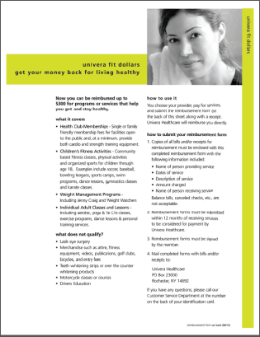
FitDollars Money back for living healthy!
Up to $300 reimbursed for healthy programs and services
Health club memberships
Children’s fitness activities
Weight loss classes
Adult classes and lessons (aerobics, yoga, dance etc.)
You choose your provider! (reimbursement based)
24

Slide 25
Improving Health Outcomes

Slide 26
Univera HealthyU

Slide 27
HealthyU Overview
A Clinically Based, Data-Driven Risk Reduction Program
Measure
Biometric Screening
5 to 36 panel lab results including
Blood Pressure
LDL Cholesterol
HDL Cholesterol
Fasting Glucose
Triglycerides
Seamless Data Integration
Data collected electronically and integrated into other EHP care management programs
Monitor
Actionable Reports
Personal health report for each participant
Employer group aggregate report (includes health improvement/trends)
Comprehensive Marketing & Communications Support
Access to private health management website
Event promotion material that are easy-to-use and customize
Univera Healthcare branded program for quality and consistency you’d expect
Effective Engagement
Opt-in telephonic health education programs
Outreach call to high risk individuals
Mid-year QuickCheck
Proactive doctor integration through opt-in Physician Link™
Reward
Fully Developed Incentive Structure
Use of comprehensive and fully developed incentive structure that encourages employees to practice prevention
Assistance with understanding regulation on incentive
Event Participant List
A list of participants, names only, that may be used for tracking and incentive purposes
HIPAA Compliant
Assistance with understanding the regulations on wellness program incentives

Slide 28
Experience Engaging Hourly and Salaried Employees
Engagement Factor | Salaried | Hourly
Message | Professional, credible, efficient, gain more energy | Privacy, confidentiality, Feel better (answer question – “what’s in it for me?”
Communication | CEO emphasizing potential program impact Feature article Departmental Briefing eMail reminder day before/day of Day Before/Day Off Poster Display | Testimonial from trusted co-worker Printed poster in gate/break areas Flyers in cafeteria, locker areas, Screening briefing at monthly Safety Meeting Day Before/Day Off “drop by” invites
Flexibility | Site Contact determines best event dates, times and location | Department Supervisor determines best event dates, times and location; ability to respond to un-planned changes
Work Schedule | Screen 6am -10am; 11am-2pm; 4pm-7pm Promote online appointment system | Screen 5am – 9am; 12pm-5pm; 8pm-12am Work with Supervisors on manual schedule
Access | Conference/training rooms; leverage “flex-time” | Gate/Break Areas; approved shop floor space; allocate participation time to monthly Safety Meetings; compliant with plan protocols and procedures
Adaptability | Align screenings with Open Enrollment; Safety Meetings; Flu Clinics (existing events) | Align wellness offerings to support Health & Safety initiatives (prevent recordable injuries, promote safety campaigns, appropriate referrals)
FUN | Incorporate golf “grip/swing” analysis as a single station | Promote “Are you fit to hunt?” tips (healthy venison/trout recipes; deer hunting conditioning)
Notes:
Short brief on key actions to engage hourly and salaried employees

Slide 29
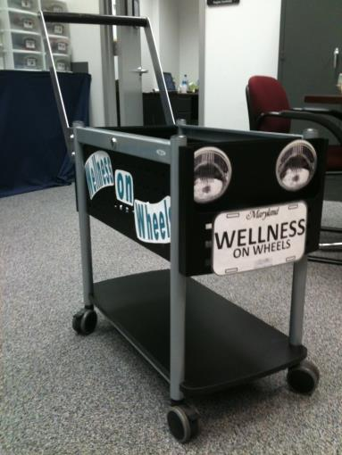
Sample Promotional Strategy:
Wellness on Wheels
Quick visits to gate or break areas
Promote health awareness and biometric screenings
Provide hand-outs on healthy snack ideas or stretches to prevent back pain
Deliver healthy snacks or treats
29
Notes:
15 second highlight on sample strategy (that can be provided as part of HU rollout or implementation meetings

Slide 30
Spring into Good Health!
Take 15 minutes to participate in our health screening and talk to a nurse or health professional about your fitness or recreational goals!
Ask your Supervisor about this year’s health screening schedule!

Slide 31
Fit for Spring and Summer Activities?
Take 15 minutes to participate in our health screening and talk to a nurse or health professional about your fitness or recreational goals!
Ask your Supervisor about this year’s health screening schedule!

Slide 32
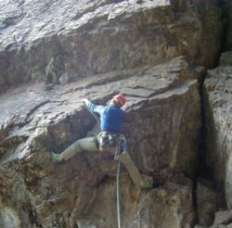
Outdoor Sports Conditioning: Practical skills to help you enjoy those important activities
Wellness
Tues. XX/XX/2017
Body weight resistance exercises you can take with you on the road
Tues. XX/XX/2017
Core exercises that will help you maintain muscle balance and prevent overuse injuries
Thurs. XX/XX/2017
Pre-season training to prepare elbows and fingers for more activity.

Slide 33
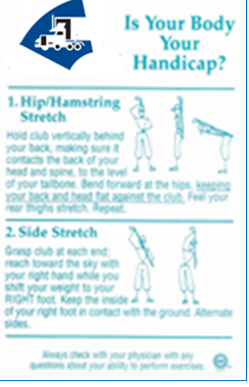
Golf Conditioning
Grip and Swing Analysis
Notes:
15 second highlight on sample strategy (that can be provided as part of HU rollout or implementation meetings

Slide 34
How it all works
1. Personalized Solutions
2. Connect Individuals to Care
4. Drive Results
3. Innovate With Purpose
Notes:
Debbie
We not only make a difference in our member’s lives….we make a difference in the marketplace.
As you evaluate your options….we realize the market has become crowded and everyone starts to sound alike
Today, you will hear how we are different and stand apart from the crowd in these 4 areas:
Personalized Solutions: Each interaction we have with a member is designed with the intent to engage with a personal, one on one experience. Every component of a member’s experience whether through the communications they receive, their biometric screenings, health coaching interactions, suggested action items, print and on-line activity…is completely tailored for each individual member based on what we learned from their biometrics and health assessment. This is possible because of our clinical rules engine that customizes not only the member’s experience but the way in which we build our clients’ programs. … I will spend more time on our rules engine in a few more minutes.
Connect to Care: We provide a member swift insights into their specific physical and emotional health risks….and connect them with the appropriate care, whether through IH resources, their physician or Griffin’s internal resources.
Innovate with a Purpose: Everything portion of our program is designed with a purpose.
We use millions of data points to identify where and how we should focus our efforts.
Whether it be the design and layout of our members’ portal site
To expanding our services to include emotional health because we analyzed the power of the mind-body connection
Or, the strategic collaboration on benefit plan design, incentive approaches, and creating a corporate culture of wellbeing
Drive Results: All of these components working together drive measuarble results and health improvement which we will spend time on later today.

Slide 35
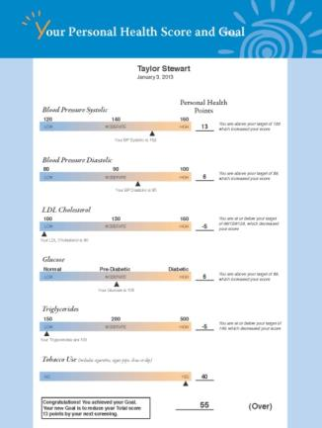
Data Drives Improved Health Outcomes
Comprehensive Clinical Blood Test
Cardiovascular disease risks, high cholesterol, high blood pressure, diabetes
Personal Health Report, Interactive Health Index, and Goal
Printed results mailed, plus an online virtual medical record

Slide 36
Outcome Accountability = Results
Effective Incentive Program
Targets controllable health factors
Achievable goals based on clinical standards
71% of members reach their health goal
76% of members with website activity reach health goal
22 point improvement when emotional distress is resolved
19
36
Notes:
Debbie

Slide 37
Sources of College/University Distress
Employees
Workload
Supervisor conflict
Relationship problems
Parenting/elder care
Sleep
Job dissatisfaction
Physical health problems
Finances
Students
Academics
Advisor conflict
Relationship problems
Family problems
Sleep
Career uncertainty
Physical health problems
Finances

Slide 38
Mind-Body Connection
Health Coaching & Emotional Health Risk
Intervention based on DASS 21*
Outreach - Licensed Behavioral Health Clinicians
Connection to Care: EAP and internal resources
Year Round Interventions and Resources
Personalized Communication
Action Steps Link Physical & Emotional Health:
Personal Health Report
Behavioral Risk Assessment
Member Portal
*http://www2.psy.unsw.edu.au/dass/
19
38
Notes:
Debbie open with methodology of WHY/How we evaluated the need for mind-body connection
Kelly & Courtney support clinical discussion
Debbie:
We used our own data to measure the impacts of emotional health on our clients’ populations
We analyzed 10 years of data across 400,000 lives
We looked at common conditions with emotional health risks compared to those with no distress
As you would imagine….those with low risks had lower distress risks. Those with higher physical risks, had greater emotional risks.
We leverage DASS 21, depression, anxiety and stress scale, within our Health Assessment, to risk stratify one’s emotional well-being.
Not only do we include print and on-line resources regarding someone's’ emotional well-being…..we also outreach within the 10 days of the biometric screenings to those with moderate to severe emotional health risks.
Our staff that reaches out to members are licensed clinical behavioral specialists
The goal is warm transfer the member to your EAP, your health plan, community resources and in the most extreme situations use our crisis intervention protocols
We are set apart from all other wellness vendors in our ability to provide a comprehensive data set which allows us to uniquely identify emotional health risk, its connection and impact on physical health, with strategically focused interventions, that allows us to meaningfully assess the effectiveness of these interventions.

Slide 39
Program Results
58% of participants found to have a health issue that they did not know about or were aware of but are not managing properly
23% assessed to be high risk for a heart attack or stroke
2-3% have a severe potentially life-threatening issue
19% assessed to have a pre-disposition to diabetes

Slide 40
Program Results
81% of participants achieved their health goal
26% of smokers QUIT SMOKING. 42% when combined with Univera Quit for Life Program
64% of members with elevated glucose, reduced their glucose levels
82% of members with elevated blood pressure, improved their blood pressure

Slide 41
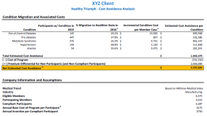
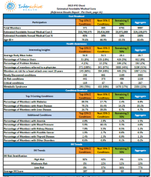
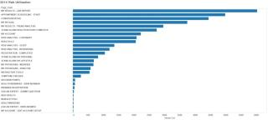
Use Data to Drive Health Outcomes
Program Results
Data-driven approach to assess, monitor & measure results
Participation and compliance reporting
Program outcomes, includes location
specific results
Cohort risk migration statistics, trends and benchmarking
Web utilization
5.9%
Notes:
Debbie

Slide 42
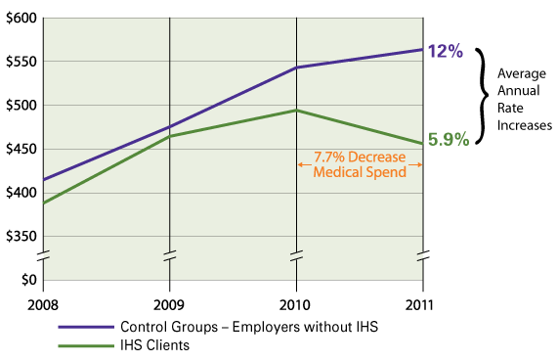
Program Results
Univera HealthyU
Trend on Investment: Medical Spend PMPM
Employer Groups not using the program: Average annual rate increase of 12%
Employer Groups using the program: Average annual rate increase only 5.9%
Employer Groups using the program: 7.7% reduction in medical spend
Independent study of actual claims experience conducted by Zoe Consulting Inc., a two-time
C. Everett Koop award winning consultant

Slide 43
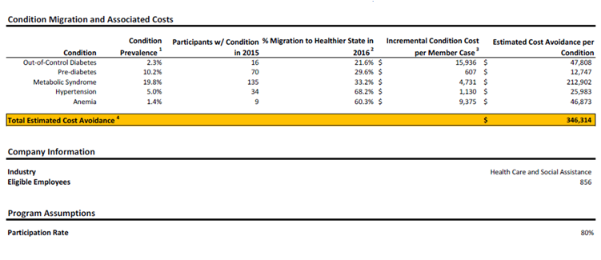
HealthyU Max Illustration Drive Results = Risk Migration & Cost Avoidance
Program Results
12
43
Notes:
Debbie
We recognize the first goal of Griffin’s program is a strong member experience.
These additional savings could provide another competitive advantage for Griffin.
In order to illustrate the potential impact our program could have on Griffins bottom line our on-staff credentialed actuary, has created a customized “cost avoidance model”. The goal of this model is to show that, in addition to the amazing innovation and health improvements that will result from our program, partnering with Interactive Health also makes good business sense.
Systematic approach to participation and engagement.
We’ve customized this model based on companies in our book of business who are in the healthcare industry and those members who tested in both 2014 and 2015
Our analysis has shown that these companies exhibit similar levels of health risk as well as a comparable propensity for health improvement with our comprehensive program.
This information allows us to estimate the total number of Griffin participants who would test in an at-risk range for each of five (5) key conditions during the first year, along with the estimated likelihood of migrating to a healthier state in one year of the program. While this analysis is not meant to be exhaustive, it can provide a conservative estimate of cost avoidance and overall return on investment which, compared to the overall cost of the program, we think is incredibly compelling.

Slide 44
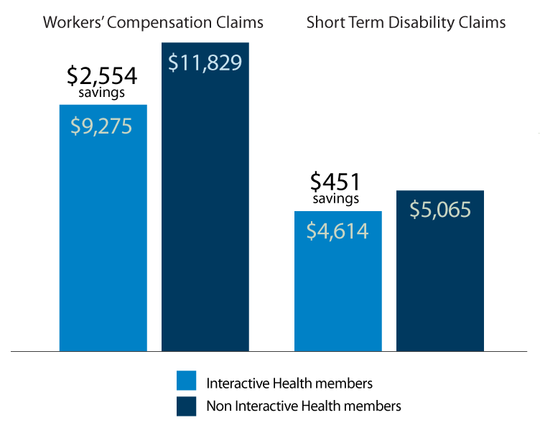
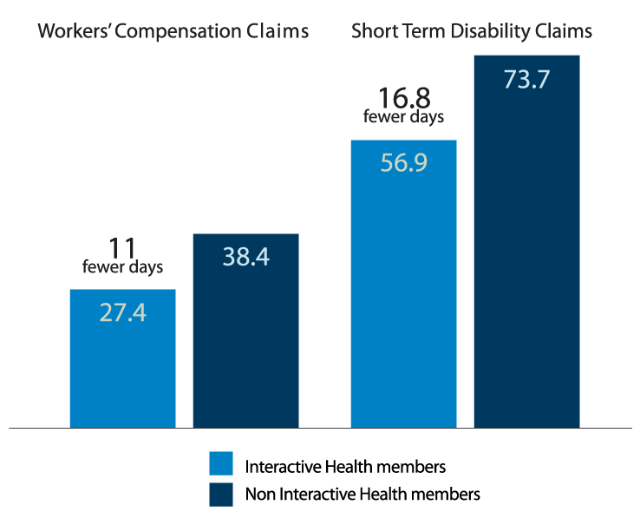
Proven Results: Impact on Health and Performance
Average claim costs:
$2,554 lower Workers’ Compensation
$451 lower STD
Recovery costs:
11 fewer days on Workers’ Compensation
16.8 fewer days on STD
12
Source: Zoe Consulting, Inc.
44
Notes:
Debbie

Slide 45
College/University Health Risk Migration Trend: Value on Investment: Diabetes Management Migration
Year 2 Risk Level
Year 1 Risk Level
Level of Diabetic Risk | Healthy | Pre-Diabetes | Diabetes | Out of Control
Healthy | 97% | 17% | 4% | 3%
Pre-Diabetes | 3% | 75% | 21% | 11%
Diabetes | 0% | 5% | 50% | 20%
Out of Control | 0% | 4% | 25% | 66%
Grey Box Member group remained with same risk category
Green Box Member group with decreased risk and improved health
Red Box Member group with increased risk
17,251 1531 348 445
Year 2 Results
97% of members in the healthy range remained in this category
17% improvement from pre-diabetes to healthy category
25% of members within the diabetic range moved to lower risk categories
34% of members in the out-of-control range moved to lower risk categories
Notes:
Cathy
The risk levels are defined as follows:
A1c: State Fasting Blood Glucose
<5.7 Healthy <110
5.7:6.4 Pre-Diabetes 110:125
6.5:6.9 Diabetes 126:149
>7.0 Out of Control >=150

Slide 46
Demonstrated Workplace Wellness Leadership Experience
Delivering wellness to college and university settings requires expertise
Flexibility is a must
Ensuring privacy and confidentiality is key
We provide professional staff that are internally trained and pay-rolled employees to ensure the highest quality and on-time service delivery
Tailoring communications to engage a diverse staff. We show your employees that we care and understand their needs
Ability to align and support your health and safety initiatives (as appropriate)

Slide 47
Implementation Strategy

Slide 48
Dedicated Implementation Team
Shared work plan with ongoing status updates
Automated end-to-end tracking process
Dedicated team to facilitate open enrollment process
On-site presence, multi-shift staffing if required
Custom communication, printing services available
Support for continuity of care
Dedicated resources for pharmacy integration
Options for enrollment transition (electronic, web, paper)
Custom landing page linked to the Daemen College internal employee website

Slide 49
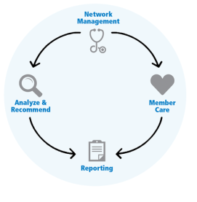
Your GreenTeam
Your account management and consulting team will
Implement your plan
Identify future needs
Recommend cost reduction and health improvement initiatives
Provide exceptional group and member service
Support wellness initiatives
Provide regular clinical reviews with medical director
Network Navigator
GreenTeam

Slide 50
Our Commitment to Daemen College
Largest upstate network and exclusive concierge service
Smooth transition for members and administrators
Proven programs for claim management and cost control
Superior world class, local service
Best in class information consulting
Best in class web tools and HR administration
Your employees will get the very best care, at the highest quality facilities,
at the lowest total cost.

