Slide 1


YOUR BENEFITS GUIDE
2025 – 2026 PLAN YEAR

Slide 2



Benefits Basics
ELIGIBILITY
As a full-time Daemen employee, you are eligible for benefits. Benefits are effective on the first day of the month following your date of hire for staff and admin, and effective the date of hire for faculty. You may enroll your eligible dependents for coverage once you are eligible. Your eligible dependents include your legal spouse, domestic partner, and / or your children up to age 26.
Once your benefit elections become effective, they remain in effect until the end of the benefit year. You may only change coverage within 30 days of a qualified life event or during Open Enrollment in the spring.
QUALIFYING LIFE EVENTS
Generally, you may change your benefit elections only during the annual enrollment period. However, you may change your benefit elections during the year if you experience a qualified life event, including:
Marriage
Divorce or legal separation
Birth of your child
Death of your spouse or dependent child
Adoption of or placement for adoption of your child
Change in employment status of employee, spouse or dependent child
Qualification by the Plan Administrator of a child support order for medical coverage
Entitlement to Medicare or Medicaid
You must notify Employee Engagement within 30 days of the qualified life event.
Depending on the type of event, you may be asked to provide proof of the event. If you do not contact HR within 30 days of the qualified event, you will have to wait until the next annual enrollment period to make changes (unless you experience another qualified life event).

Slide 3


Medical Coverage
Daemen promotes good health!
Daemen offers medical coverage for employees, spouse and children, including coverage for prescription drugs and free preventive care services. Please remember to get your free annual wellness exam every year.
MEDICAL COVERAGE
DEDUCTIBLE
Daemen University offers employees health insurance through the Univera Signature Hybrid 1 Plan. Employee share of premium is calculated annually and open enrollment takes place in April with changes effective June 1st. Dependent children may be covered until age 26 regardless of full time student status. Domestic partners are covered. The Plan requires all covered employees to select a participating primary care physician for each family member enrolled.
You must meet an annual deductible before the medical plan begins to cover a portion of your costs with the exception of copay services. Once the deductible is met, the medical plan begins to pay for a percentage of covered expenses (this is called coinsurance).
OUT-OF-POCKET MAXIMUMS
Out-of-pocket maximums apply in-network and out-of-network. This is the maximum amount you will pay for health care costs in a calendar year. Once you have reached the out-of-pocket maximum, the plan will fully cover eligible medical expenses for the rest of the benefits plan year. If you see an out-of-network provider, you may be responsible for out-of-pocket costs that are considered above the “reasonable and customary” fees.
PREMIUMS
The employee share of the premium is deducted from the bi-weekly paycheck, the first two paychecks of every month. If there are 3 pay periods in a month, the 3rd pay day will not include deductions for medical benefits. If an employee receives a salary increase during the plan year which results in them moving to a new tier, their contribution rate will be adjusted accordingly.
WELLNESS YOUR WAY
The Daemen medical plans provide a $250.00 wellness card to be used during the Plan year to purchase vitamins and supplements from a participating health food store; as credit towards gym membership, chiropractic co-pays or massages. You can register and claim the rewards in one of two ways. Online, log into your Univera account, and go to Health and Wellness > Rewards & Incentives > Wellness Your Way. Or call 1-800-327-7130 and use option 1 for Member.

Slide 4

Medical Coverage
 | Univera Signature Hybrid 1 | Univera Signature Deductible 3
Physician Copay Specialist Copay | $30 $30 | 20% after Deductible 20% after Deductible
Hospital Copay | $500 | 20% after Deductible
Outpatient Surgery Copay | $75 | 20% after Deductible
Emergency Room | $100 | 20% after Deductible
Urgent Care | $50 | 20% after Deductible
Prescription Drug | $10/$50/$100 2 Copays / 90 Day Supply | $10/$50/$100 after Deductible 2.5 Copays / 90 Day Supply
Dependent Rider | 26 / 26 | 26 / 26
Domestic Partner Coverage | Included | Included
Wellness Benefit | $250 Wellness Rider | $250 Wellness Rider
In‐Network Deductible Coinsurance Out‐of‐Pocket Maximum | $500 / $1,000 $6,350 / $12,700 | $2,000 / $4,000 (True Family) 80% / 20% $5,000 / $10,000
Out‐of‐Network Deductible Coinsurance Out‐of‐Pocket Maximum | $1,000 / $2,000 (Embedded) 60% / 40% $6,350 / $12,700 | $2,000 / $4,000 (True Family) 60% / 40% $5,000 / $10,000
Employee Cost Share for Univera Signature Hybrid 1 (Brooklyn)
Single Coverage Family Coverage | $207.07 per pay $539.09 per pay

Slide 5

Flexible Spending Accounts
The Daemen Flexible Spending Account is administered by Benefit Resource. FSAs are available to enrollees of the Univera Signature Hybrid 1 Plan. Flexible spending accounts allow covered employees to pay for certain premiums, medical and dependent care expenses on a pre-tax basis. Paying for these expenses with pre-tax dollars saves money by lowering taxable income. Please be aware that Social Security benefits may be reduced in the future when funding a Flexible Spending Account. A tax advisor can assist with determining how the tax savings will compare to possible reductions in future benefits. The minimum contribution to enroll in the flexible benefit plans is $400 and the plan year runs June 1st – May 31st. The medical expenses account allows for $500 to be rolled over without forfeitures. Maximum contributions, covered expenses and dependent eligibility and forfeiture rules are governed by IRS regulations. Newly hired eligible employees may enroll within thirty days of their hire date and must re-enroll annually thereafter.
Example of How to Save on Your Taxes with an FSA
The chart below is an example of how much you can save when you use the FSAs to pay for your predictable health care and dependent care expenses throughout the year.
 | With FSA | Without FSA
Your taxable income | $50,000 | $50,000
Pre-tax contribution to Health Care and Dependent Care FSA | $2,000 | $0
Federal and Social Security taxes* | $11,701 | $12,355
After-tax dollars spent on eligible expenses | $0 | $2,000
Spendable income after expenses | $36,299 | $35,645
Tax savings with the Medical and Dependent Care FSA | $654 | N/A
*This is an example only, and may not reflect your actual experience. It assumes a 25% federal income tax rate marginal rate and a 7.7% FICA marginal rate. State and local taxes vary, and are not included in this example. However, you will also save on any state and local taxes as well.
For additional information regarding the FSA go to:
www.benefitresource.com

Slide 6

Health Saving Accounts
The Daemen Health Spending Account is administered by Lakeshore Savings Bank. Health spending accounts are available to enrollees of the Univera Signature Deductible 3 Plan and allow covered employees to pay for certain medical, dental, and vision expenses on a pre-tax basis. Paying for these expenses with pre-tax dollars saves money by lowering taxable income. Daemen contributes annually in June to participant HSA accounts. In addition, Employees can set up their own pre-tax contributions through payroll deductions. The plan year runs June 1st – May 31st and any funds remaining on May 31st are rolled over without forfeitures. Maximum contributions, covered expenses and dependent eligibility and forfeiture rules are governed by IRS regulations. Newly hired eligible employees may enroll within thirty days of their hire date and must re-enroll annually thereafter. The pro-rated share of the annual employer contribution will be deposited into employee’s HSA accounts each quarter. The employer contribution is pro-rated for those who enroll in the plan after the June 1st Open Enrollment date.
Employer HSA Contribution
Coverage Level | (HSA)
Single | $1,500
Family | $3,000
Daemen Contribution to Health Spending Account (HSA) – Univera Signature Deductible 3 Plan
* Single Plan HSA Annual Contribution $1,500 ($375/quarter)
* Family Plan HSA Annual Contribution $3,000 ($750/quarter)
The HSA pro-rated employer contribution is deposited quarterly the first pay
period of June, Sept., Dec., Mar.
(The annual employer contribution is pro-rated based on date of enrollment)
*Note: you cannot have an FSA and HSA at the same time

Slide 7
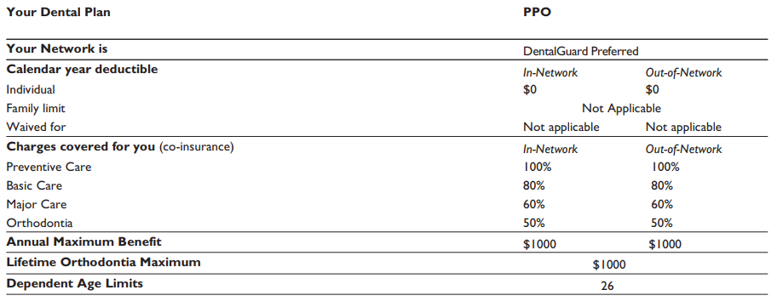
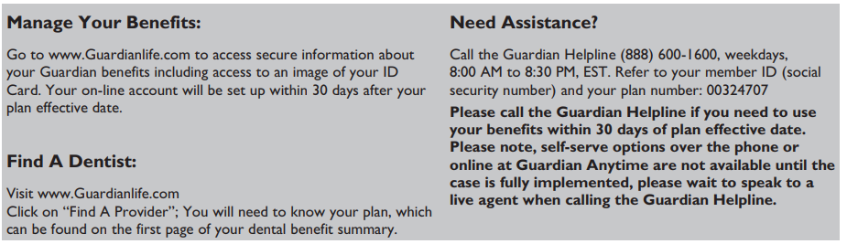
DENTAL COVERAGE
Dental coverage is administrated by Guardian. The Plan is a preferred provider arrangement but employees may elect to see a non-participation dentist that will be reimbursed at the Guardian negotiated rate for all services rendered. The Plan includes an orthodontic rider for children under the age 19. Maximum benefit of $1000.00 per enrolled family member per calendar year. Coverage begins the first of the month after date of hire. Coverage is extended to age 26 for dependent children. The employee share of the premium is deducted from the bi-weekly paycheck, the first two paychecks of every month. If there are 3 pay periods in a month, the 3rd pay day will not include deductions for dental benefits.
Coverage Level | Bi-Weekly Cost
Single | $4.24
Family | $10.60

Slide 8
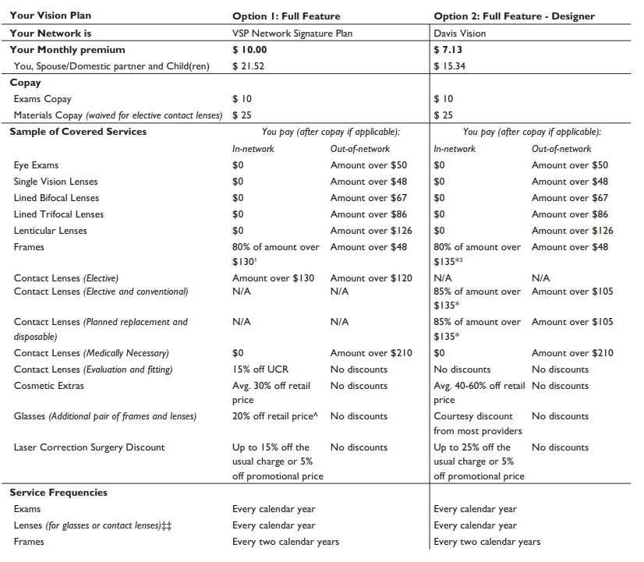
VISION COVERAGE
Low group rates are available for full vision insurance products utilizing either the VSP or Davis Vision networks administered by Guardian Life Insurance. Family coverage includes children to age 26. Employee pays 100% of the cost for this benefit with a pre-tax, biweekly payroll deduction. If there are 3 pay periods in a month, the 3rd pay day will not include deductions for vision benefits.
Coverage Level | Option 1 | Option 2
Single | $5.13 | $3.66
Family | $11.04 | $7.87

Slide 9
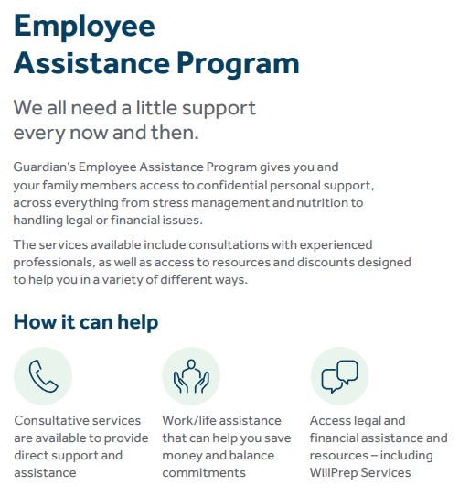
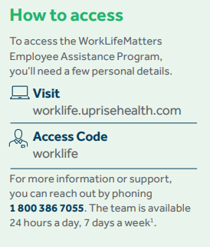

EMPLOYEE ASSISTANCE PROGRAM

Slide 10
LIFE AND AD&D INSURANCE COVERAGE
All full-time employees working at least 30 hours per week are covered by a $50,000 Life Insurance Policy and Accidental Death and Dismemberment (AD&D) Insurance through Lincoln Life. This benefit is fully paid for by Daemen.
SUPPLEMENTAL LIFE INSURANCE
You may choose to elect additional life insurance. If the amount you selected during OE is over the Guarantee Issue amount, an approval will be required, and you will be asked to collect an Evidence of Insurability (EOI) and submit it to your employer. Your full election amount will not be approved until this document is received.
The Guaranteed Issue amount for new voluntary life insurance is up to $150,000 for employee only this 2022 plan year, and newly elected spouse/child(ren) coverage is $10,000. Any amount chosen over this will require you to complete and Evidence of Insurability form, which must be reviewed and approved by Lincoln before you are accepted for that insurance amount over the guaranteed issue amount.
SHORT TERM DISABILITY
This plan is offered at no cost after six months of full-time employment. Salary is continued for the first ninety days upon receipt of a completed and validated New York State disability form. There is a seven-day waiting period from the date of disability before benefits become effective. This plan is administered through Guardian.
LONG TERM DISABILITY
This plan is offered at no cost to all full-time employees after ninety days of employment. The Plan provides for replacement of salary at 2/3 for length of disability or normal retirement age whichever is less. There is a ninety-day elimination period before benefits begin. This plan is administered through Guardian.
 | Short-Term Disability | Long-Term Disability
Benefits Begin | 7 Days after Disability | 91 Days after Disability
Percentage of Income Replaced | 100% salary continuation | 66.67% salary
Maximum Benefit | 3 Months | Length of disability or normal retirement age, whichever is less

Slide 11

GROUP TRAVEL ACCIDENT
This Plan provides benefits for both domestic travel greater than one hundred miles from your legal residence as well as international travel. There is no elimination period of cost for this benefit. Travel must be business related.
RELOCATION EXPENSE
Upon approval of the appropriate Dean or Vice-President, the university pays up to one-half the cost of moving normal household goods (not to exceed $3000.00 and excluding charges for packaging, storage or insurance). Actual receipts are required; photocopies are not accepted.
RETIREMENT PLAN
All benefit-eligible employees may participate in the Retirement Plan the first of the month following their date of hire. After one year of service, the university contributes 8% for all employees that contribute 5% on a pre-tax basis. Employees may join the plan immediately after hire with match if they have completed one year of full-time service at another college or university in the twelve months prior to hire. The Teachers Insurance and Annuity Association (TIAA) administers this plan.
* Twelve months of full-time service in higher education immediately prior to employment at Daemen will be counted towards the waiting period, as long as a letter from the previous college’s or university’s HR department is provided upon hire.

Slide 12
STAFF VACATION ACCRUAL
Daemen University provides full time employees with paid vacation time. Hours begin accruing with the first full two-week pay period and the employee may begin taking accrued time after three months of employment. Employees may accrue up to thirty days of vacation.
Full time hourly employees accrue two weeks vacation per year. Hourly vacation accrual increases to three weeks per year after five years of service and four weeks per year after ten years of service.
Full time salaried employees accrue four weeks vacation per year.
HOLIDAYS
The University observes the following holidays. Most full-time employees are excused from work with pay on these days:
There may be times when it becomes more advantageous for both the University and the employee to have the day AFTER Christmas and New Year’s off instead of the day before. In addition, the University may occasionally change the Holiday Schedule as circumstances require. When this occurs, you will be informed accordingly.
The University typically closes during the week between Christmas and New Year’s. This will be announced during the Fall of each year. If the University closes, full time employees are excused from work with pay, except for some essential staff.
New Year’s Eve
New Year’s Day
Martin Luther King Day
President’s Day
Good Friday
Easter Monday
Memorial Day
Juneteenth
Independence Day
Labor Day
Indigenous People’s Day
Thanksgiving Day
Friday after Thanksgiving
Christmas Eve
Christmas Day
SICK/PERSONAL TIME
Full and part time hourly employees will accrue leave time at a rate of 1 hour per 30 hours worked upon hire. This benefit time rolls over each year to a maximum of 56 hours and is not paid out upon separation of employment.
Full time salaried employees (including Faculty) receive paid sick leave in case of any injury, illness, medical condition or any of the reasons covered by NYS Sick Leave. Sick leave will accrue at a rate of 3.5 hours per pay period to a maximum of 84 hours. Sick time will rollover each year to a maximum of 84 hours. Sick leave is not paid out upon separation of employment.

Slide 13

DAEMEN TUITION WAIVER BENEFIT
Full time employees are eligible for 100% tuition waiver for undergraduate classes at Daemen University the semester after hire. This benefit is also available to the employee’s spouse/same sex domestic partner and dependent children.
100% tuition waiver for graduate level courses at Daemen University are available to full time employees and the spouse/same sex domestic partner of the employee. Dependent children of the employee are eligible for a 50% tuition waiver.
CIC SCHOLARSHIP PROGRAM
Full time employees and their dependents as defined by IRS regulations are eligible to apply for tuition benefits through the CIC networks of schools. Charges covered by this program are determined by the host institution but generally cover full tuition. This benefit is available the semester after hire and covers undergraduate courses only.
TUITION EXCHANGE SCHOLARSHIP PROGRAM
Applications for Tuition Exchange scholarships are accepted for dependent children of full-time employees after five years of service. There are over 500 colleges and universities nationwide participating in the Tuition Exchange Program and scholarships are not guaranteed.

Slide 14

IMPORTANT CONTACTS
Plan | Contact | Phone Number | Website
Medical Plan | Univera | 800-499-1275 | www.univerahealthcare.com
Dental | Guardian | 888-600-1600 | www.guardianlife.com
Vision | Guardian | 888-600-1600 | www.guardianlife.com
Flexible Spending Accounts | Benefit Resource | 800-473-9595 | www.benefitresource.com
Health Savings Account | LakeShore Savings | 716-898-2101 | lakeshoresavings.com
Life & AD&D Insurance | Guardian | 888-600-1600 | www.guardianlife.com
Employee Assistance Program (EAP) | Guardian | 888-600-1600 | www.guardianlife.com
403(B) Retirement Plan | TIAA | 800-842-2252 | http://www.tiaa.org/

Slide 15
Please contact hr@daemen.edu
for benefit questions.

