Slide 1



Health Savings Account

Slide 2

At Lake Shore Savings, our Health Savings Accounts (HSA) is designed to fit your family’s needs.
If you currently have a high-deductible health insurance plan, then an HSA from Lake Shore Savings gives you and your loved ones the flexibility to put at ease any medical expense worries you may come across. Our HSA account is interest-bearing and fee-free, and you can manage the account via our Online Banking and Mobile Banking app.

Slide 3

Features of an HSA account with Lake Shore Savings
Competitive interest rates
Checks or a debit card to make payments directly to your doctor or pharmacy
No monthly service charge
No minimum balance requirements
Monthly statements generated
Combined year end tax statements listing contributions and distributions
Funds distributed via: debit card, ATM transaction, check, Online Banking and bill pay, cash withdrawal

Slide 4



Eligible Medical Expenses
Expenses applied to your health plan deductible
Dental care
Vision care
Pharmacy prescriptions
Over-the-counter medications
Medical equipment

Slide 5
After Retirement
After age 65, HSA funds may be withdrawn for non-eligible expenses with no penalty (regular income tax will apply).
Prior to age 65, funds used to pay non-eligible medical expenses are subject to normal income tax and a 20% penalty.
After age 65, you may use your HSA account to pay for insurance premiums, including Medicare.
Don’t Have Funds at Account Opening
You can pay for products and services from another source (ie. credit card or checking account) and reimburse that account when sufficient funds are deposited in the HSA.
Keep good records of all monies in and out for audit purposes.

Slide 6
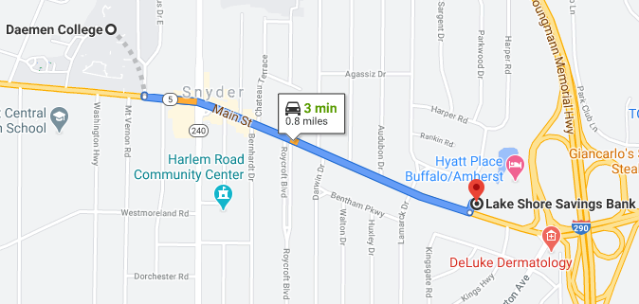
THANK YOU
Richard Greco
Assistant Vice President, Regional Branch Sales Manager
P
716-898-2101
E
richard.greco@lakeshoresavings.com
4950 Main Street
Snyder, New York 14226

